Slide 1



HR analytics output
View in Power BI
Last data refresh:
3/2/2023 2:02:47 PM UTC
Downloaded at:
3/2/2023 3:06:49 PM UTC

Slide 2
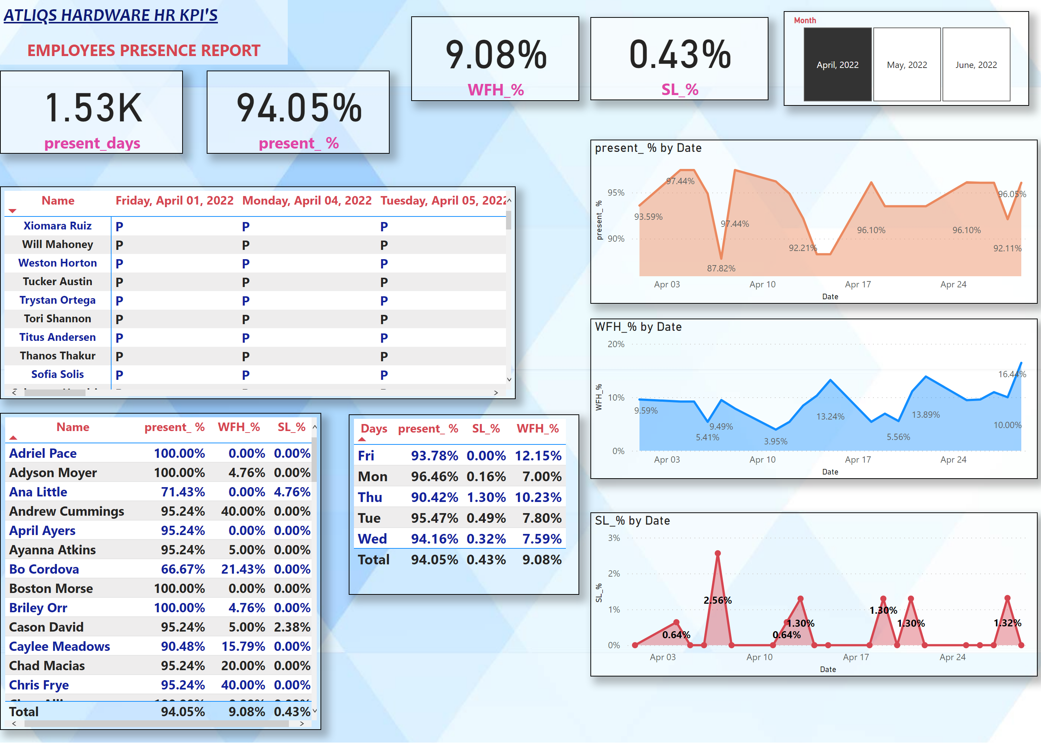
Page 1
Notes:
card
No alt text provided
slicer
No alt text provided
card
No alt text provided
card
No alt text provided
card
No alt text provided
tableEx
No alt text provided
textbox
No alt text provided
pivotTable
No alt text provided
stackedAreaChart
No alt text provided
stackedAreaChart
No alt text provided
stackedAreaChart
No alt text provided
tableEx
No alt text provided

